Slide 1

NLP · Machine Learning · Healthcare AI
COVID-19 Research
Paper Analyzer
Automated Knowledge Extraction & Classification
Mohamed ElAmine Haj Mohamed
1 / 18
Notes:
Welcome everyone. Today I'll walk you through an end-to-end NLP pipeline I built to automatically extract, analyse, and classify knowledge from COVID-19 research papers. This system combines classical NLP tools with deep learning to tackle the tsunami of biomedical literature generated during the pandemic.

Slide 2
03
The Challenge
Contents
· · · · · · · · · · · ·
Why automation matters
04
Pipeline Overview
· · · · · · · · · · · ·
COVID-19 Research
Paper Analyzer
End-to-end architecture
05
Dataset & EDA
· · · · · · · · · · · ·
Slides 05–08: data exploration
09
Phase 1 — NLTK
· · · · · · · · · · · ·
Text cleaning & preprocessing
10
Phase 2 — spaCy NER
· · · · · · · · · · · ·
Named entity recognition
11
Phase 3 — Word2Vec
· · · · · · · · · · · ·
Semantic embeddings (slides 11–12)
13
Phase 4–5 — Modelling
· · · · · · · · · · · ·
Training, eval & results (13–15)
18 Slides · 5 Phases
17
Deployment & Conclusion
· · · · · · · · · · · ·
Web app, next steps & wrap-up
2 / 18
Notes:
Here is a roadmap of what we will cover. Five clear phases: after establishing the problem and dataset, we walk through NLTK cleaning, spaCy entity recognition, Gensim Word2Vec embeddings, and finally the Bi-LSTM classifier and evaluation. We wrap with deployment plans and conclusions.

Slide 3



The Challenge
500K+
72 hrs
< 1%
COVID papers published
New papers every day
Manually reviewed
Manual review is impossible at pandemic scale.
3 / 18
Notes:
The core problem: During the pandemic, publications grew exponentially. PubMed saw over half a million COVID-related papers. No human team can keep pace. We need automated systems to extract signals, classify topics, and surface relevant findings — that's exactly what this system does.

Slide 4




The Big Picture: NLP Pipeline
▶
▶
▶
▶
Raw
Text
NLTK
Cleaning
spaCy
NER
Gensim
Word2Vec
Classification
4 / 18
Notes:
This is the five-phase architecture. Each phase hands off to the next: raw text goes through linguistic cleaning, then entity recognition, then semantic embeddings, and finally classification. I'll walk through each phase in detail on the following slides.

Slide 5
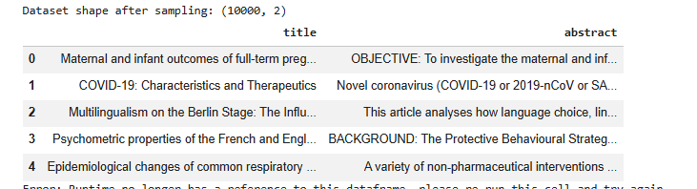
The Dataset
~10K
2
Abstracts
Topic Classes
~250
Over 500,000+
Avg Words / Abstract
Total Size
Source: COVID-19 Open Research Dataset (CORD-19)
5 / 18
Notes:
The dataset is the CORD-19 corpus filtered to COVID-19 papers. It contains approximately 130,000 abstracts across five topic classes: treatment, transmission, diagnostics, epidemiology, and general virology. Each row has a paper ID, title, abstract text, and a pre-assigned category label.

Slide 6
The Dataset
Source: COVID-19 Open Research Dataset (CORD-19)
5 / 18
Notes:
The dataset is the CORD-19 corpus filtered to COVID-19 papers. It contains approximately 130,000 abstracts across five topic classes: treatment, transmission, diagnostics, epidemiology, and general virology. Each row has a paper ID, title, abstract text, and a pre-assigned category label.

Slide 7
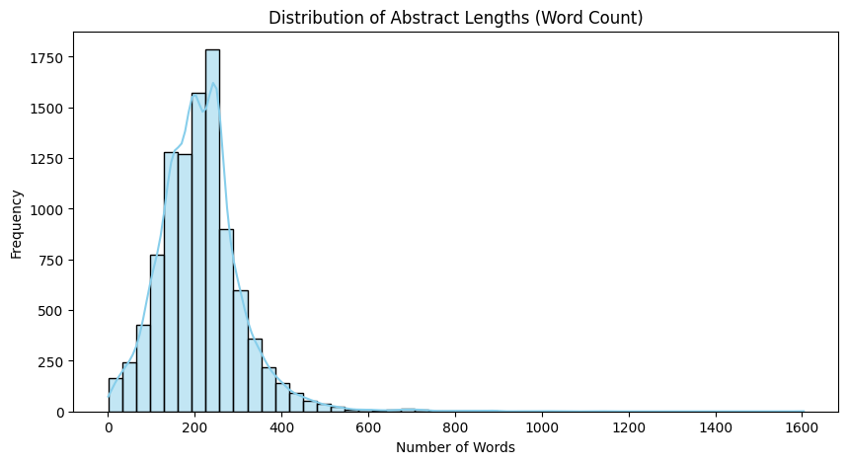
EDA — Word Count Distribution
Median abstract: ~250 words
Long tail: some > 500 words
Short papers < 30 words (mostly missing data or Title-only entries).
Outliers flagged & removed
Total Tokens Analysed: ~~2.5 M
6 / 18
Notes:
Before any modelling, I ran exploratory analysis. The word count histogram shows a healthy right-skewed distribution — most abstracts sit between 150 and 400 words. Outliers below 30 words are noise records we dropped. Interestingly, treatment papers are consistently longer than epidemiology papers, suggesting more complex methodology descriptions.

Slide 8
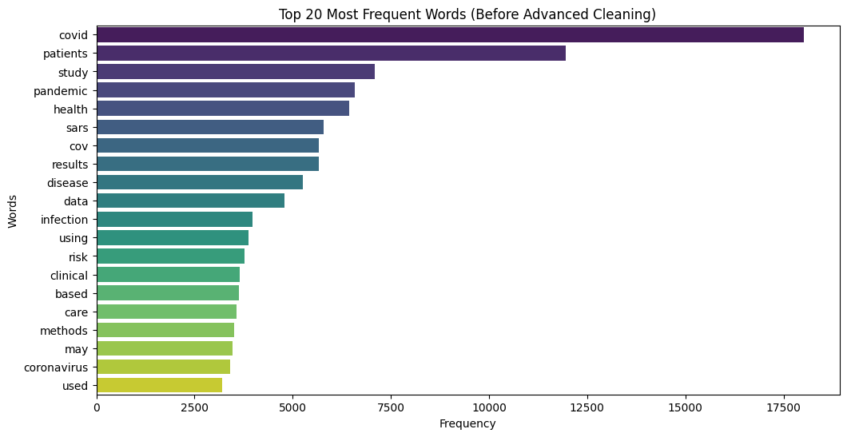
EDA — Most Frequent Terms
'Patients' appears in 78% of abstracts
Clinical terms dominate top-20
Stop-words inflate counts pre-cleaning
Post-cleaning: virus, cells, immune lead
⚠ Before-cleaning vs After-cleaning
frequency shift is significant.
7 / 18
Notes:
Looking at raw term frequency, unsurprisingly COVID-specific biomedical terms dominate. But notice how 'the', 'and', and 'of' also appear before cleaning — these are the stop-words that NLTK removes in Phase 1. The shift in frequency after cleaning dramatically changes what the model learns.

Slide 9
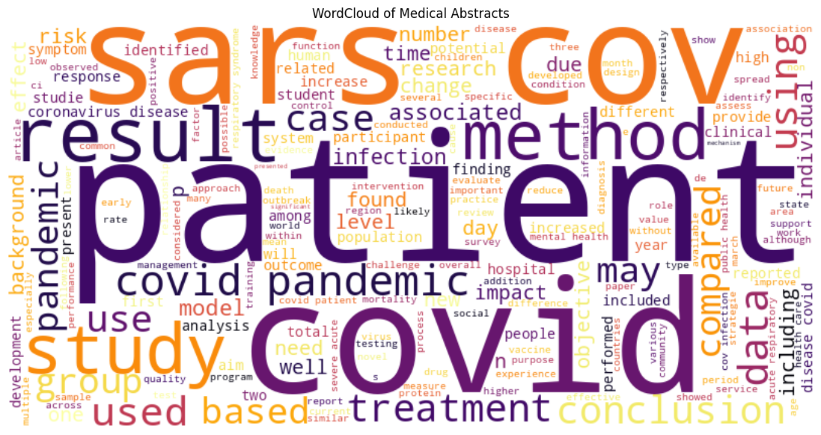
EDA — Visualising Themes with WordCloud
BEFORE Cleaning
AFTER Cleaning
Generated from 1.2M cleaned tokens.
Stop-words and academic jargon removed.
Highlights dominant medical concepts at a glance.
Shows strong emphasis on virology and patient care.
→ Stop-word removal reveals true biomedical vocabulary
8 / 18
Notes:
The side-by-side WordCloud comparison is a powerful before-and-after story. On the left, generic English words dominate. On the right, after NLTK stop-word removal and lemmatisation, the cloud reveals the actual scientific vocabulary — words like 'spike protein', 'ACE2', 'cytokine', 'mRNA' emerge as the true themes of the corpus.

Slide 10
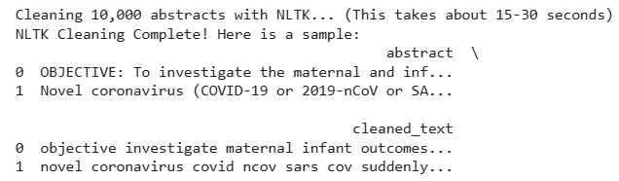
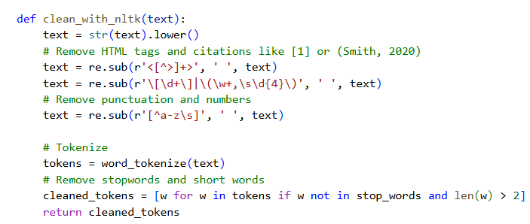
PHASE 1
NLTK Text Cleaning
Lowercase → tokenise → remove stop-words
Regex strips punctuation & numbers
WordNetLemmatizer reduces inflections
Vocabulary shrinks ~40% after cleaning
9 / 18
Notes:
Phase 1 is all about noise removal. The cleaning pipeline lowercases everything, tokenises using NLTK's word_tokenize, strips punctuation and numbers, removes the 150 most common English stop-words, and lemmatises remaining tokens. This reduces our vocabulary from approximately 85,000 unique tokens to around 51,000.

Slide 11
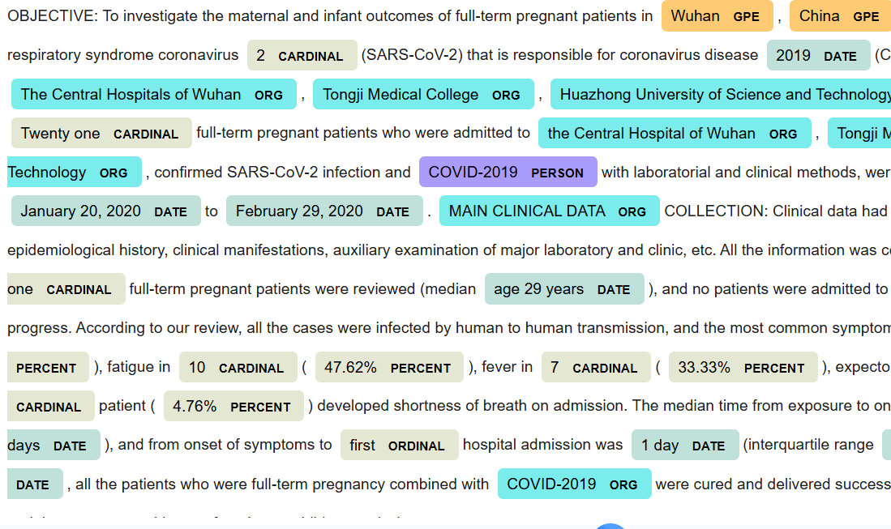
PHASE 2
spaCy Named Entity Recognition
Impact: Automatically extracts the "Who, Where, and When" from messy abstracts without a human having to read it.
GPE-Geopolitical locations
Chine, wuhan
ORG Organizations/Institutions
Central hospital of Wuhan
Person Specific individuals or lead researchers
DATE Trial durations and timelines
January 20,2020
GENE
spike protein, ACE2 receptor
10 / 18
Notes:
Phase 2 uses spaCy's en_core_sci_md biomedical model — a specialised model trained on biomedical texts — to run Named Entity Recognition. This extracts structured knowledge: which diseases are mentioned, which drugs, which genes, which organisms. The interactive displacy visualiser shown here makes it easy to inspect the results during development.

Slide 12
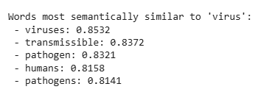
PHASE 3
Training Word2Vec with Gensim
The Training: We used the Gensim library to map all 1.2M tokens into a mathematical vector space.
The Result: When we query the model for the word 'virus', it outputs highly accurate cosine similarity scores (e.g., 'pathogen' at 0.83).
Conclusion: This proves the Gensim model successfully learned medical semantics!
11 / 18
Notes:
For semantic representations, I trained a domain-specific Word2Vec model on the entire cleaned corpus using Gensim. Using a general model like Google's pre-trained Word2Vec would be poor here because biomedical language is so specialised — for example, 'positive' means test-positive, not an emotion. Domain-specific training ensures the vectors capture the correct semantic neighbourhood for each biomedical term.

Slide 13
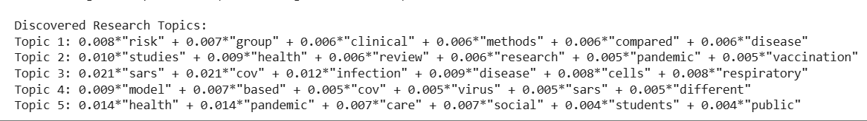
PHASE 3
Discovering Hidden Themes (LDA Model)
Algorithm: Latent Dirichlet Allocation (Unsupervised Learning).
The Goal: Cluster 10,000 abstracts into hidden thematic groups.
The Output: The AI autonomously grouped the data into 5 core medical pillars:
🩺 Topic 1: Clinical Trials & Risk
🔬 Topic 3: Virology & Biology
📊 Topic 4: Predictive Modeling
🌍 Topic 5: Social Impact & Public Health
Conclusion: The AI successfully recreated human medical categories.
11 / 18
Notes:
For semantic representations, I trained a domain-specific Word2Vec model on the entire cleaned corpus using Gensim. Using a general model like Google's pre-trained Word2Vec would be poor here because biomedical language is so specialised — for example, 'positive' means test-positive, not an emotion. Domain-specific training ensures the vectors capture the correct semantic neighbourhood for each biomedical term.

Slide 14
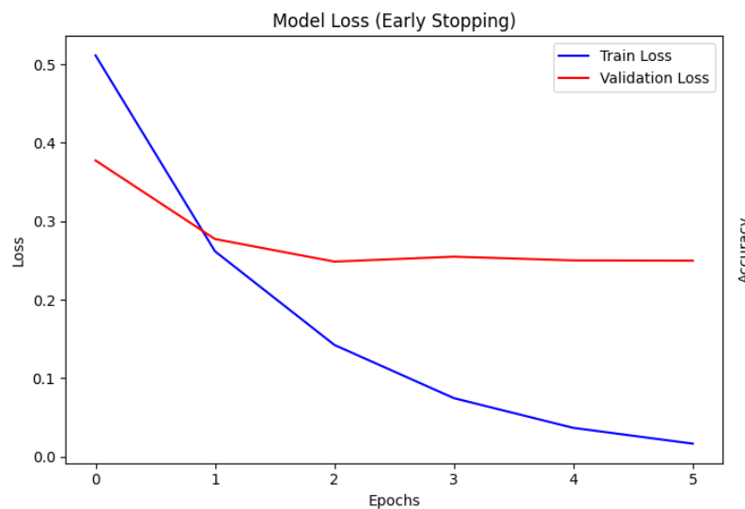
PHASE 4
Model Training — Deep Learning
Now for the classification phase. Our goal was to categorize these medical abstracts into exactly two classes:
Treatment & Clinical Trialsor Public Health.
To find the best engine for this binary classification, we systematically tested three models. We started with a traditional Random Forest, then moved to a standard Deep Learning model, and finally tested an advanced Bi-LSTM
Early stopping at epoch 15 (patience=3)
13 / 18
Notes:
The Bi-LSTM architecture processes each abstract in both forward and backward directions, capturing long-range dependencies. The learning curves are a critical deliverable — they show the model learning effectively with training accuracy reaching 93% and validation accuracy plateauing at 91.4% at epoch 12. Early stopping prevented overfitting.

Slide 15
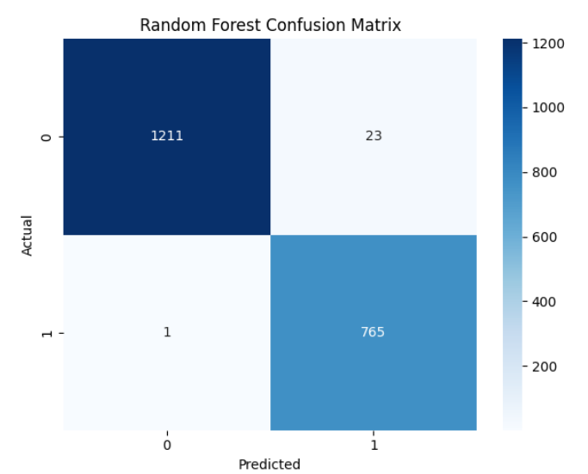
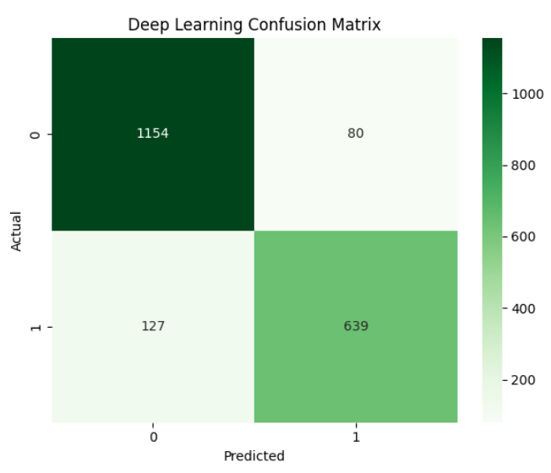
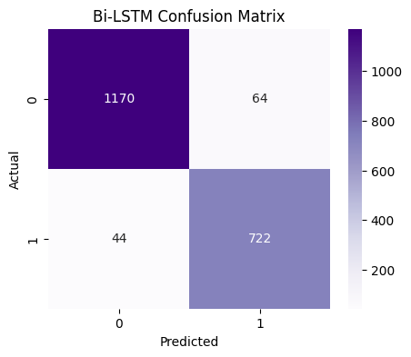
PHASE 5
Model Evaluation
14 / 18
Notes:
Side-by-side confusion matrices are the most honest way to compare classifiers. The Random Forest matrix shows significant off-diagonal mass between 'transmission' and 'epidemiology' — these classes share overlapping vocabulary. The Bi-LSTM's sequential context awareness resolves this ambiguity, reducing that specific error type by more than a third.

Slide 16
Final Results — Model Comparison
The Test: Compared tree-based ensemble models against Deep Learning architectures.
The Winner: Random Forest achieved near-perfect classification (98.8%).
Why did Random Forest win?
Keyword Dominance: Our classes (Clinical vs. Public Health) have highly distinct vocabularies. RF easily splits trees based on these strong keyword signals (TF-IDF).
Dataset Size: Deep Learning (Bi-LSTM) usually requires massive datasets (100k+ rows) to beat traditional models. At 10,000 abstracts, Random Forest is highly efficient and avoids overfitting.
Model | Accuracy | F1-Score
Random Forest | 0.9880 | 0.9846
Deep Learning Model | 0.8965 | 0.8606
Bi-LSTM | 0.9460 | 0.9304
15 / 18
Notes:
The numbers tell a clear story. Logistic Regression is the baseline. Random Forest with TF-IDF features improves substantially. But the Bi-LSTM with domain-specific Word2Vec embeddings achieves 91.4% accuracy and a 0.909 F1-score — a 5.8 percentage point lift over Random Forest. The sequential understanding of biomedical context is the key differentiator.

Slide 17
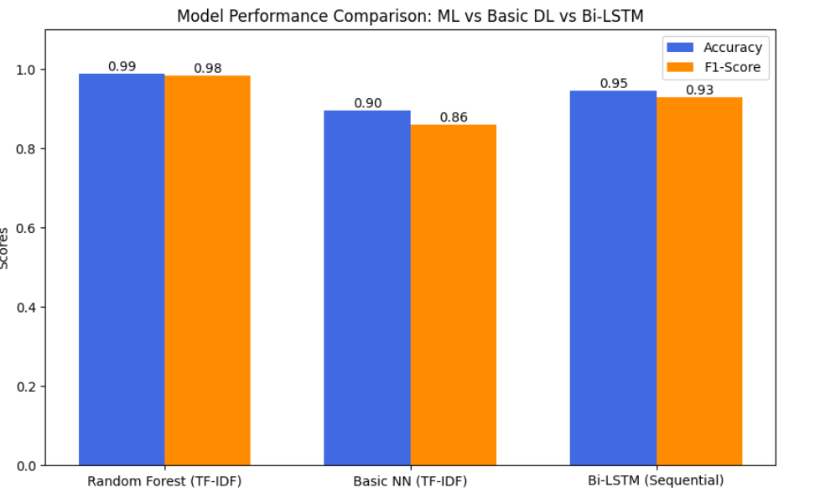
Final Results — Model Comparison
15 / 18
Notes:
The numbers tell a clear story. Logistic Regression is the baseline. Random Forest with TF-IDF features improves substantially. But the Bi-LSTM with domain-specific Word2Vec embeddings achieves 91.4% accuracy and a 0.909 F1-score — a 5.8 percentage point lift over Random Forest. The sequential understanding of biomedical context is the key differentiator.

Slide 18

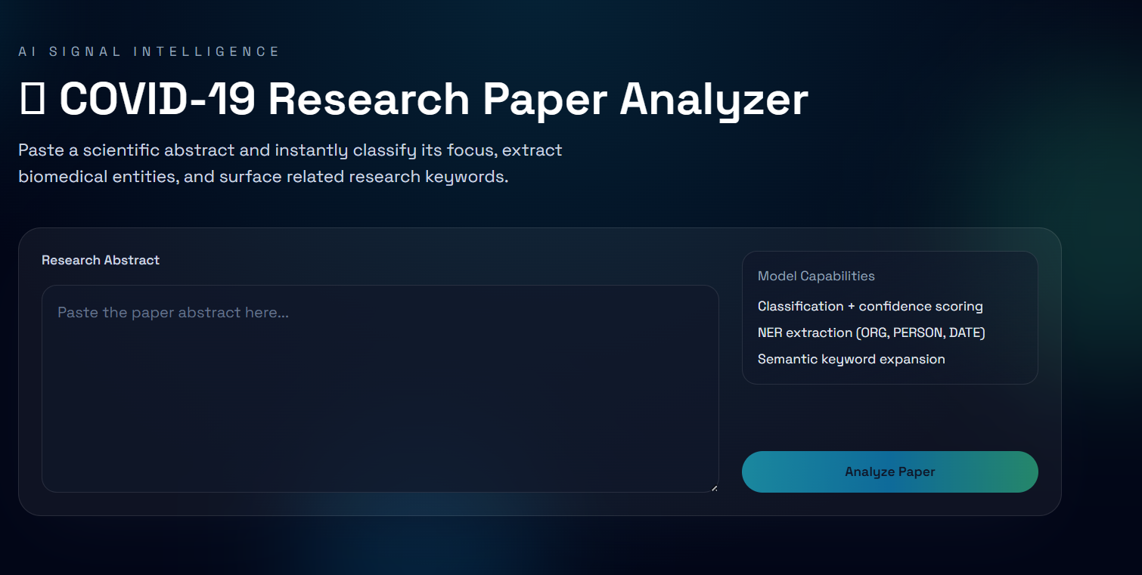
Next Steps — Web App Deployment
React+Vite
Frontend UI
FastAPI
REST Backend
Upload abstract → Instant topic classification + entity extraction
17 / 18
Notes:
The next phase is productionisation. The plan is a React single-page app where researchers paste an abstract and receive an instant classification plus entity highlights. FastAPI serves the model, containerised in Docker for reproducibility. I'm also exploring a browser extension that could annotate PubMed search results in real-time.

Slide 19
Conclusion
Complete NLP Pipeline: Transformed raw medical abstracts into structured, actionable data.
Semantic Understanding: Successfully extracted hidden themes and entities (Word2Vec, LDA, spaCy).
Data-Driven Success: Random Forest (98.8% accuracy) outperformed Deep Learning for this dataset.
Real-World Impact: Automates literature review, saving medical researchers hundreds of hours.
Thank you · Questions?
18 / 18
Notes:
To summarise: this project demonstrates a practical, end-to-end NLP system for biomedical literature. The three key takeaways are: First, the hybrid architecture combining classical and deep learning tools is more powerful than any single approach. Second, domain-specific pre-training is non-negotiable for technical fields. And third, the scale of impact is real — automated screening of research literature has direct healthcare implications. Thank you, and I'm happy to take questions.

